Slide 1
Lesson 2: Data Types in JavaScript

Slide 2
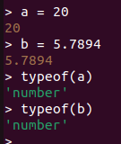
Number
Declaring Integer type variable in javascript :-
var x = 23;
let x = 20;
Declaring Floating point value in JavaScript :-
var x = 5.78945146;
console.log(x.toFixed(2));
Output: 5.78

Slide 3
JavaScript has a single number type. Internally, it is represented as 64-bit floating point, the same as Java’s double. Unlike most other programming languages, there is no separate integer type, so 1 and 1.0 are the same value. This is a significant convenience because problems of overflow in short integers are completely avoided, and all you need to know about a number is that it is a number. A large class of numeric type errors is avoided.
Ref: Douglas Crockford - JavaScript_The Good Parts (2008)

Slide 4
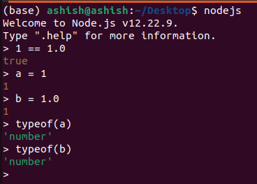
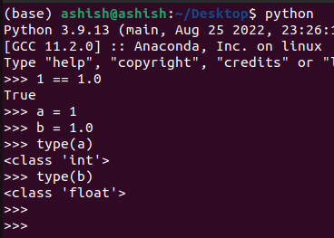
Number

Slide 5
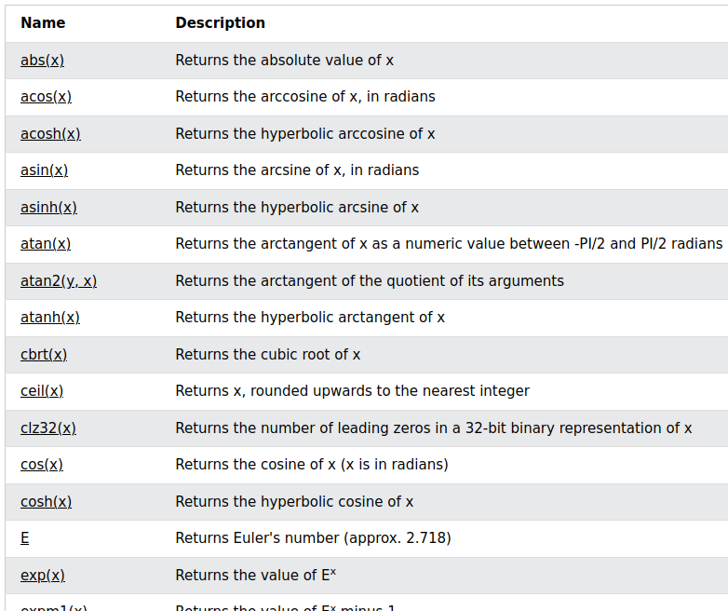
Math library of JavaScript
Ref: https://www.w3schools.com/jsref/jsref_obj_math.asp

Slide 6
Strings
Declaring String variable in JavaScript :-
// Using string template
var variable = “Gokul Krishna”
// Using String class
var variable = new String(“Gokul Krishna”);

Slide 7
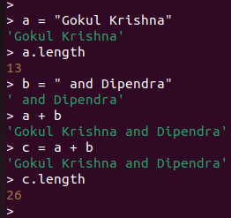
String Concatenation

Slide 8
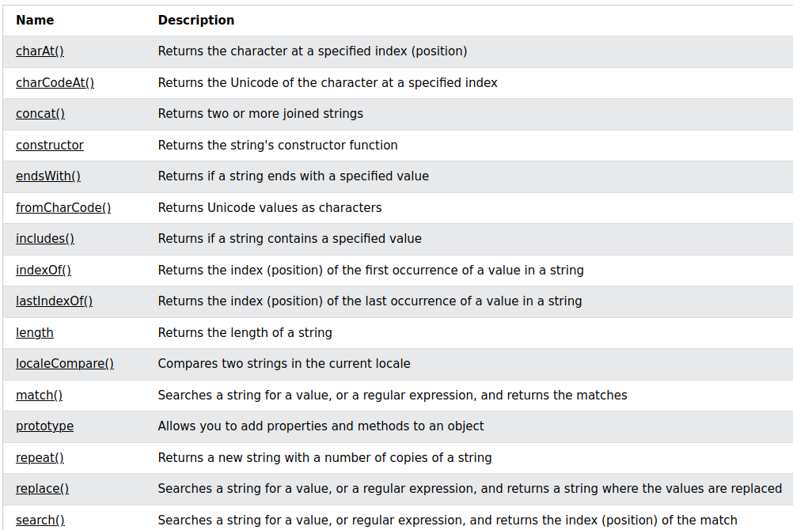
Ref: https://www.w3schools.com/jsref/jsref_obj_string.asp

Slide 9
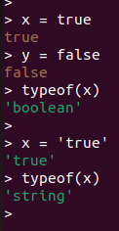

Boolean in JavaScript
let x = true;
let y = false;
let result = x.toString();
console.log(result);
In Python:

